Slide 1
X-section GC-GD
See Cross section locations.kmz & Cross section labels.kmz for location in Google Earth

Slide 2
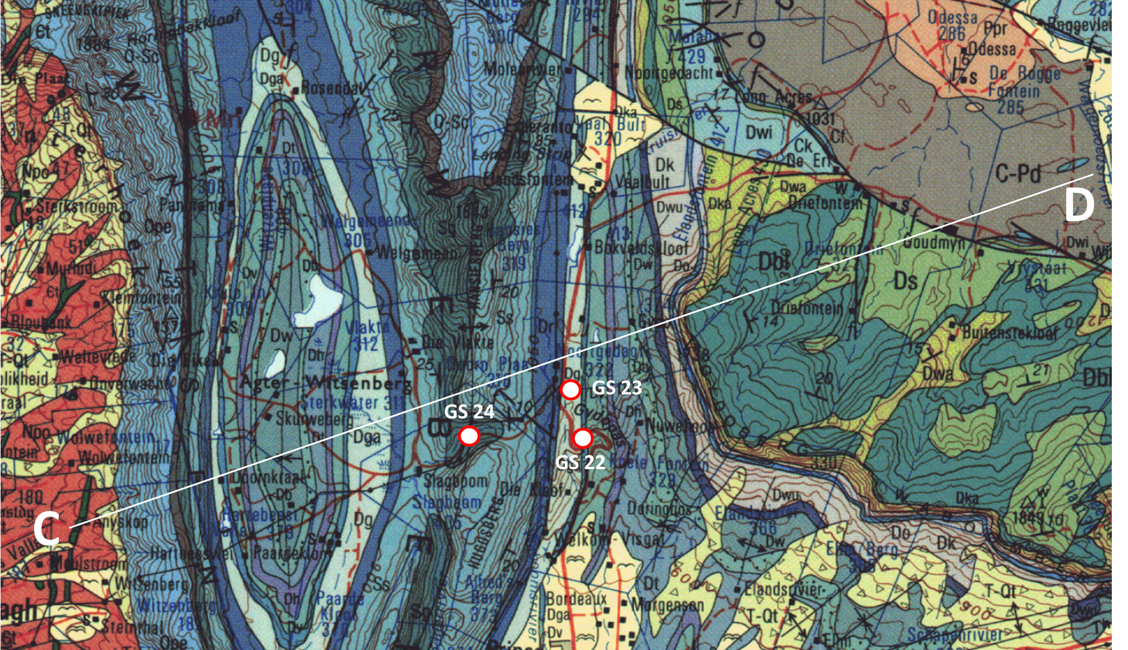

Slide 3
Sketch geologic cross-section GC-GD through the Gydo Pass area
See Stratigraphic column for 3319 Worcester for explanation of Formation codes
masl
masl
1500
1500
f
f
Sg
Dbl
1000
Dwu
1000
Dw
Ds
Ss
Dw
Db
C-Pd
Dt
Ope
Dh
Dh
Dg
Dwa
Opa & O-Sc
Dg
Dv
Dbl
Dr
Dr
Dt
Dka
500
Ss
Dga
500
Ope
Sg
Do
Ds
Npo
Npo
Dk
Dbl
0
0
0
5
10
15
20
25
30
Km
GC
GD

Slide 5
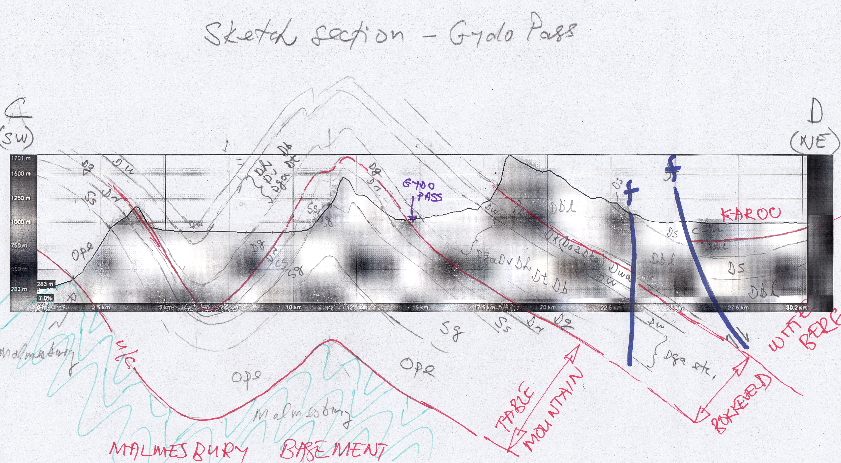
Interpretation 1

Slide 6
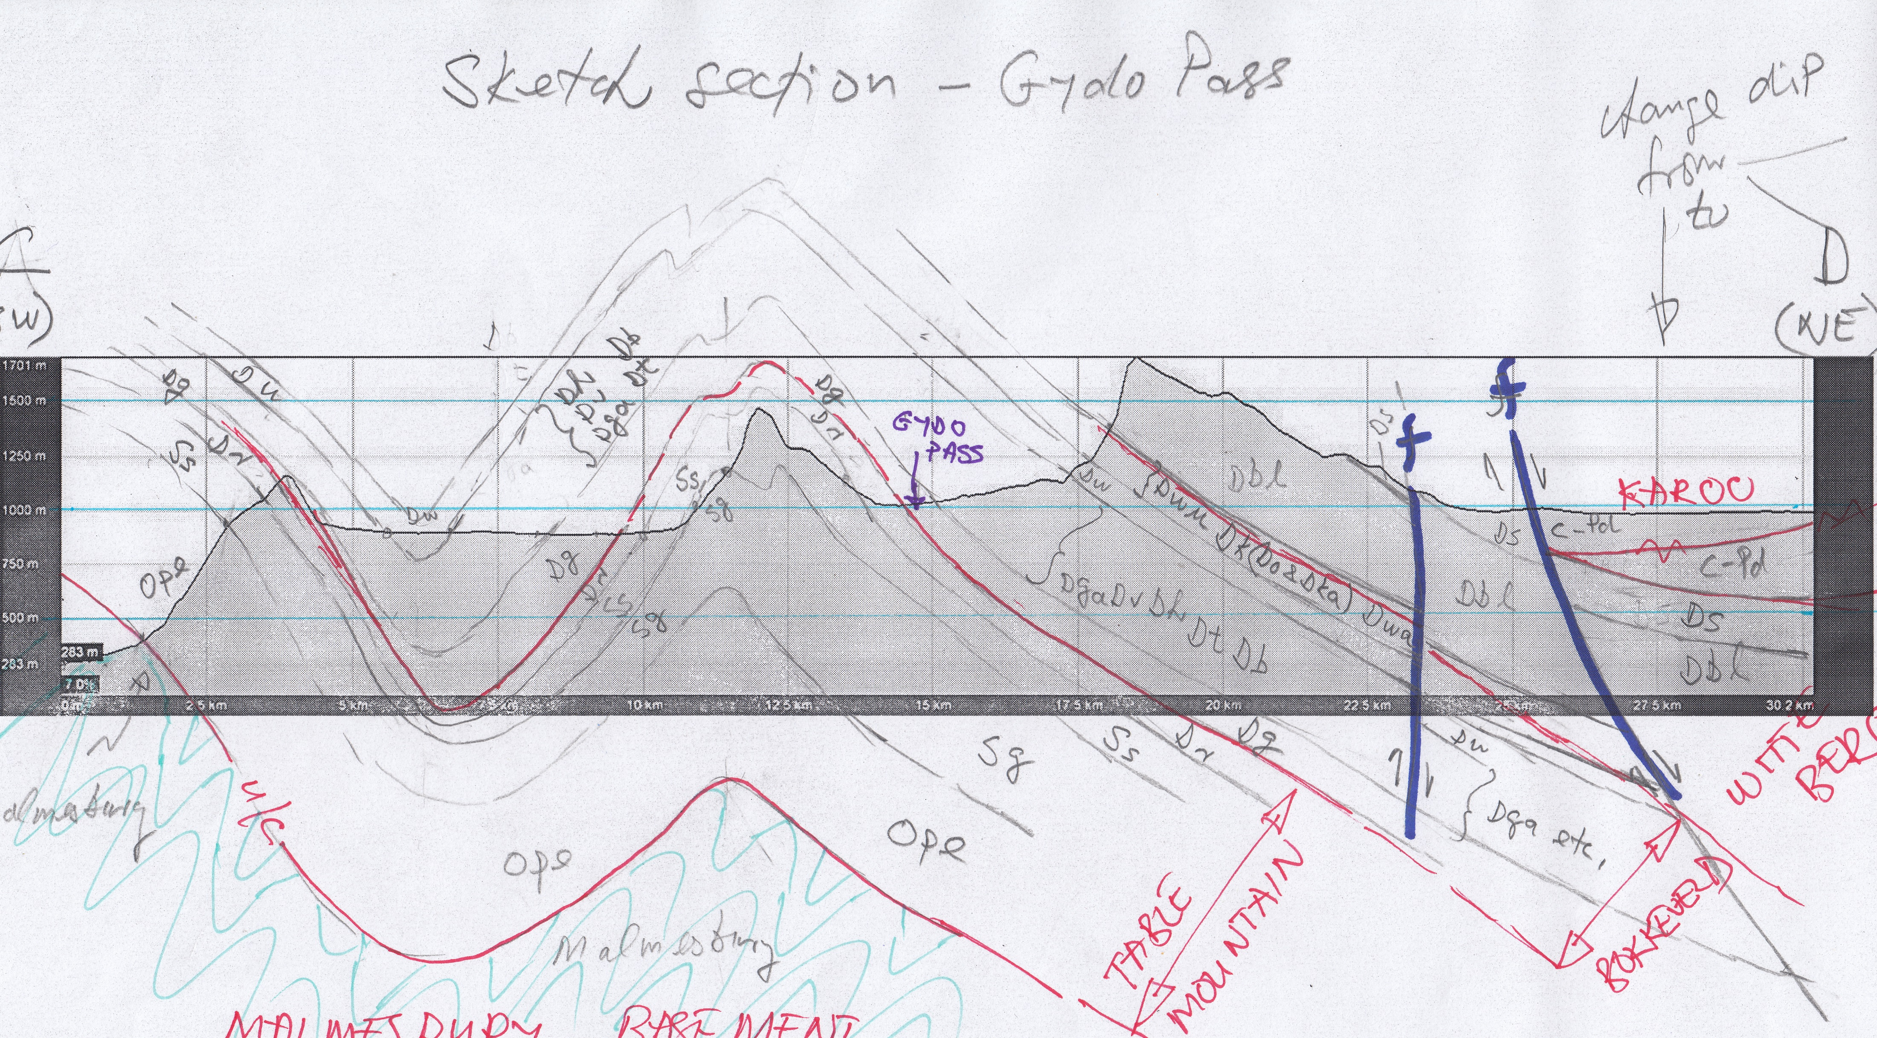
Interpretation 2

Slide 7
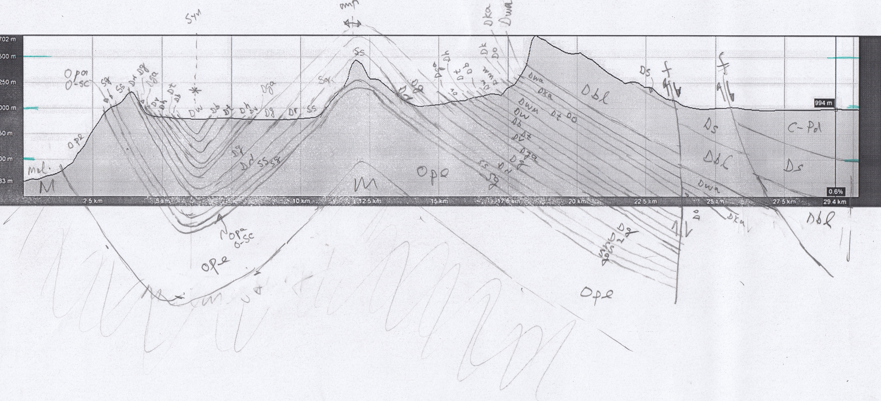
Interpretation 3

